Slide 1
Osquery explained
a deep dive in endpoint monitoring: Understand and plan Osquery
deploy on global scale

Slide 2
Thinks i’m going to talk about
EDR - endpoint detection & response:
how to build a ecosystems for mass incident detection and & response
Thinks i don’t talk about
Product pitch
What you can find on the osquery doc pages
How cool is the company I work for

Slide 3
Git clone https://github.com/nigifabio/first-osquery (the slides are going to be there)
If hash vagrant >2 /dev/null || hash –p apt-get install vagrant; vagrant; vagrant up;
Auth: user: root password: puppet
Someone is exfiltrating data..
If you are (already) getting bored..

Slide 4
Which kind of people you deal with?
What problem are we trying to solve?
Too many OS centric products to solve too narrow of a use-case
New use-case? new vendor
We are not anymore in a windows centric or single distro world
Many vendor specific languages
Too much data to collect, store and analyse
Do they escalate to IR for further investigation?
Can your IR start investigation without a confirmed incident?
Will this overload your IR?

Slide 5


SQL powered operating system instrumentation, monitoring and analytics.
Released under apache license.
Windows, macOS, CentOS, FreeBSD, and almost every Linux OS released since 2011 are supported with no dependencies.
Can be used for DEVOPS compliance and Security.
Tip
http://osquery.io/
https://github.com/facebook/osquery
https://osquery.readthedocs.io/en/stable/
Osquery 101

Slide 6
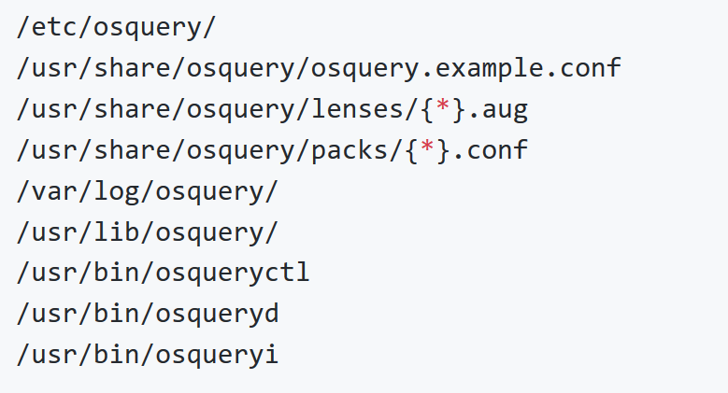
What it look like?

Slide 7
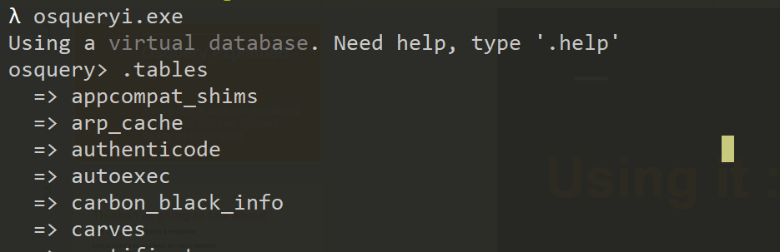
Using it : Osqueryi
Tip
https://osquery.readthedocs.io/en/stable/introduction/sql/
https://github.com/facebook/osquery/releases
to list all tables: .tables
to list the schema (columns, types) of a specific table: .schema table_name or pragma table_info(table_name); for more details
to list all available commands: .help
to exit the console: .exit or ^D

Slide 8
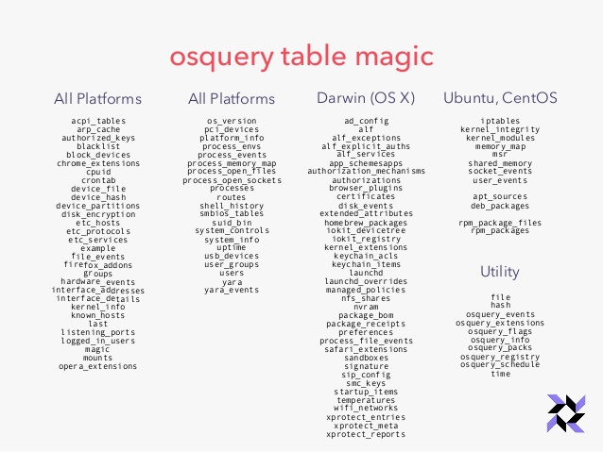
Let’s play queries!

Slide 9
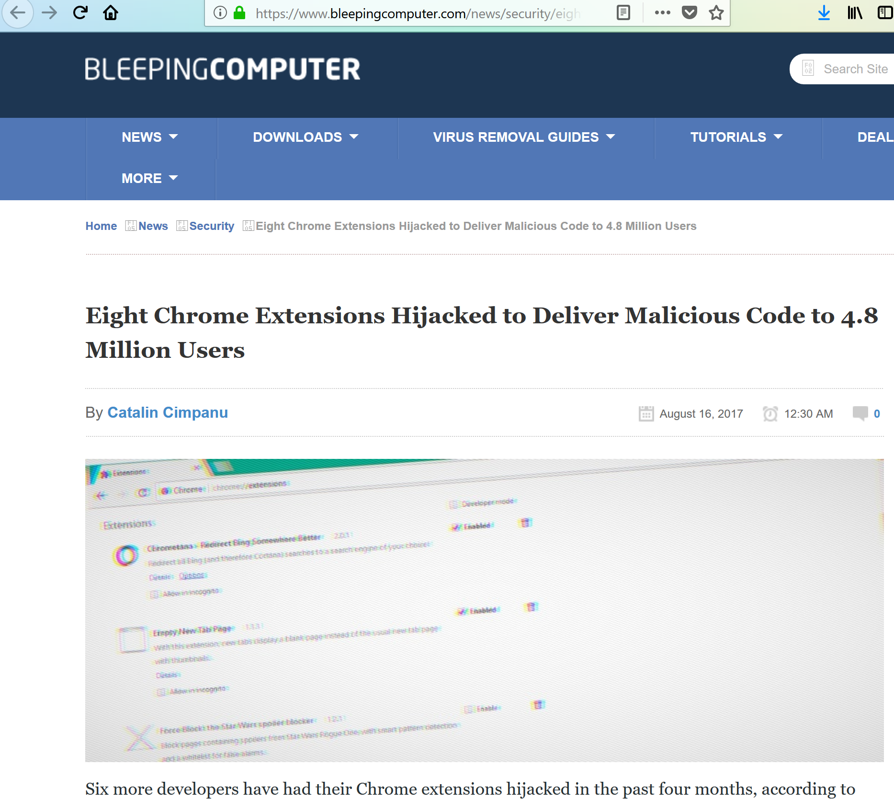
Tip
https://www.bleepingcomputer.com/news/security/eight-chrome-extensions-hijacked-to-deliver-malicious-code-to-4-8-million-users/

Slide 10
BetternetVPN SELECT * FROM users JOIN chrome_extensions USING (uid) WHERE identifier='gjknjjomckknofjidppipffbpoekiipm';", Chrometana SELECT * FROM users JOIN chrome_extensions USING (uid) WHERE identifier='kaicbfmipfpfpjmlbpejaoaflfdnabnc';", ...

Slide 11
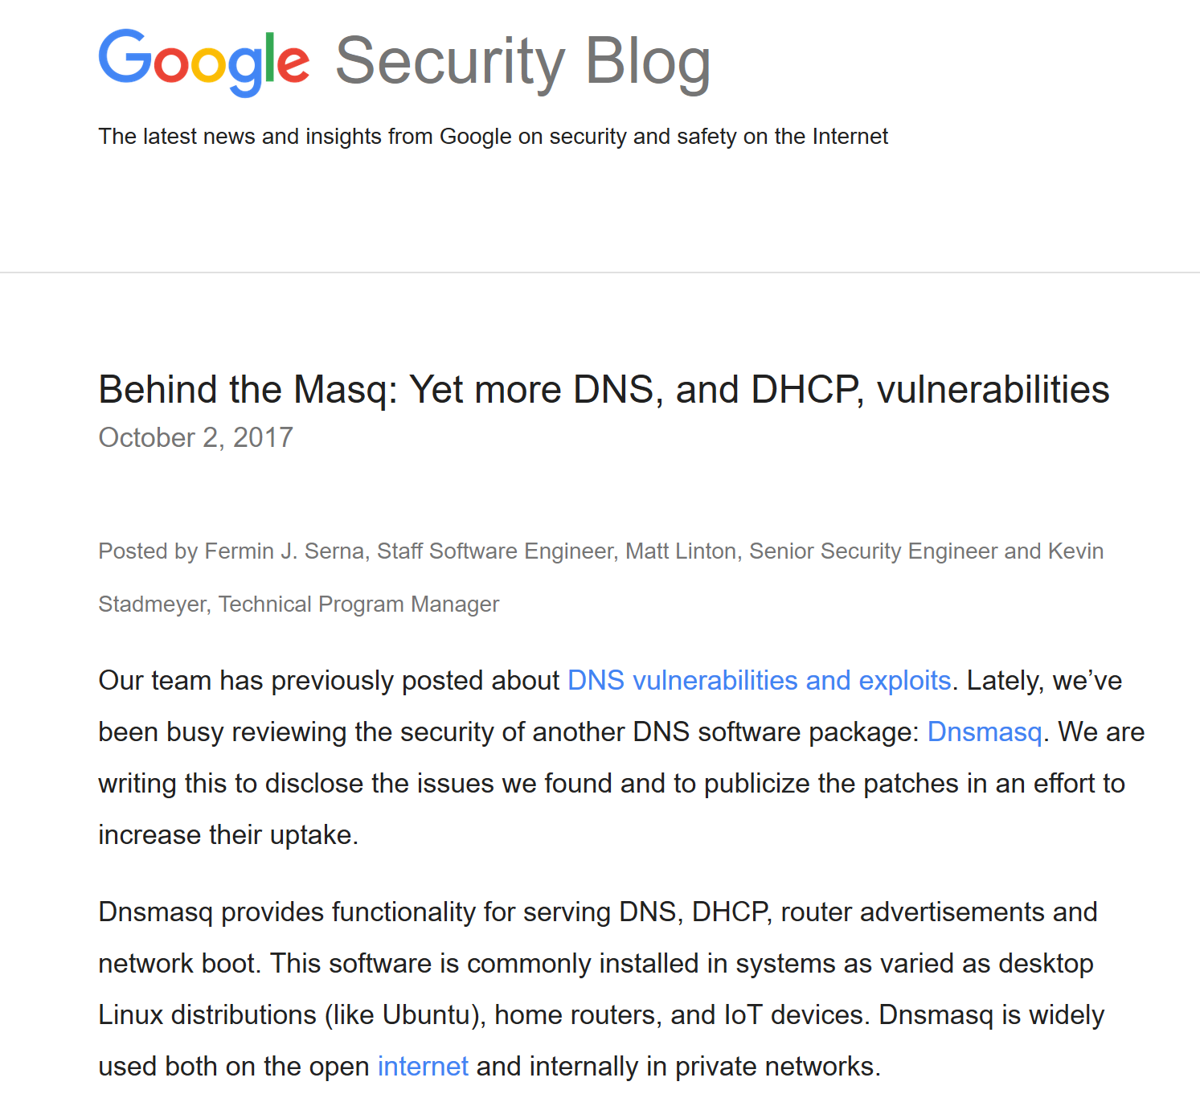
Tip
https://security.googleblog.com/2017/10/behind-masq-yet-more-dns-and-dhcp.html

Slide 12
Find dnsmasq installed via Homebrew or MacPorts by enumerating related launchd plist: SELECT * FROM launchd WHERE name LIKE '%dnsmasq%'; Find running Docker containers with dnsmasq in the name: SELECT name FROM docker_containers WHERE name LIKE '%dnsmasq%'; Discover hosts that are have dnsmasq listening on localhost port 53: SELECT DISTINCT(processes.name), process_open_sockets.local_port FROM processes JOIN process_open_sockets USING (pid) WHERE local_port=53 AND processes.name='dnsmasq'; Find users who installed dnsmasq via Homebrew: SELECT * FROM homebrew_packages WHERE name='dnsmasq';

Slide 13
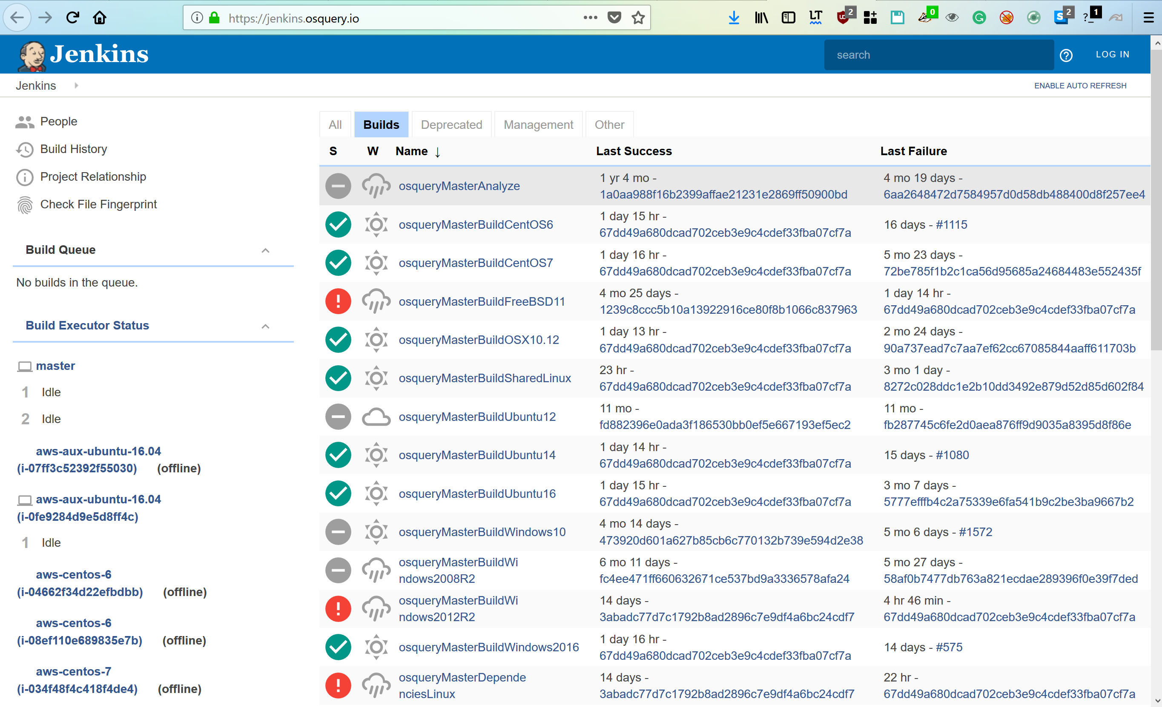
Build and test osquery for different platform
Tip
https://osquery.readthedocs.io/en/stable/development/windows-provisioning/
https://osquery.readthedocs.io/en/stable/installation/custom-packages/
For Windows: make_win64_binaries.bat
For Linux and mac: $make package && make_osx_package.sh
Automate with Jenkins!

Slide 14
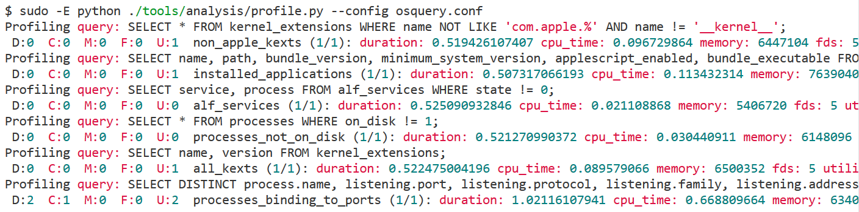
Tip
http://osquery.io/
https://github.com/facebook/osquery
https://osquery.readthedocs.io/en/stable/
Performance safety

Slide 15
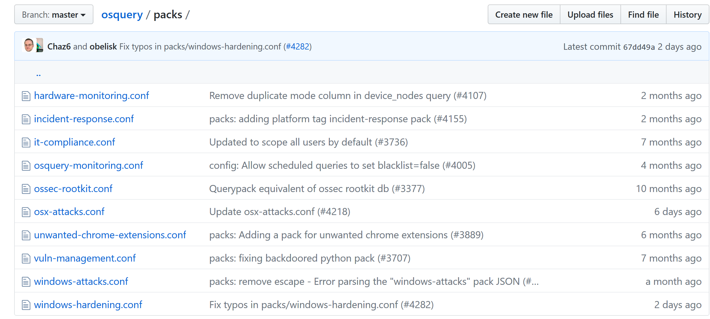
PACKS: do not re-invent the wheel!

Slide 16
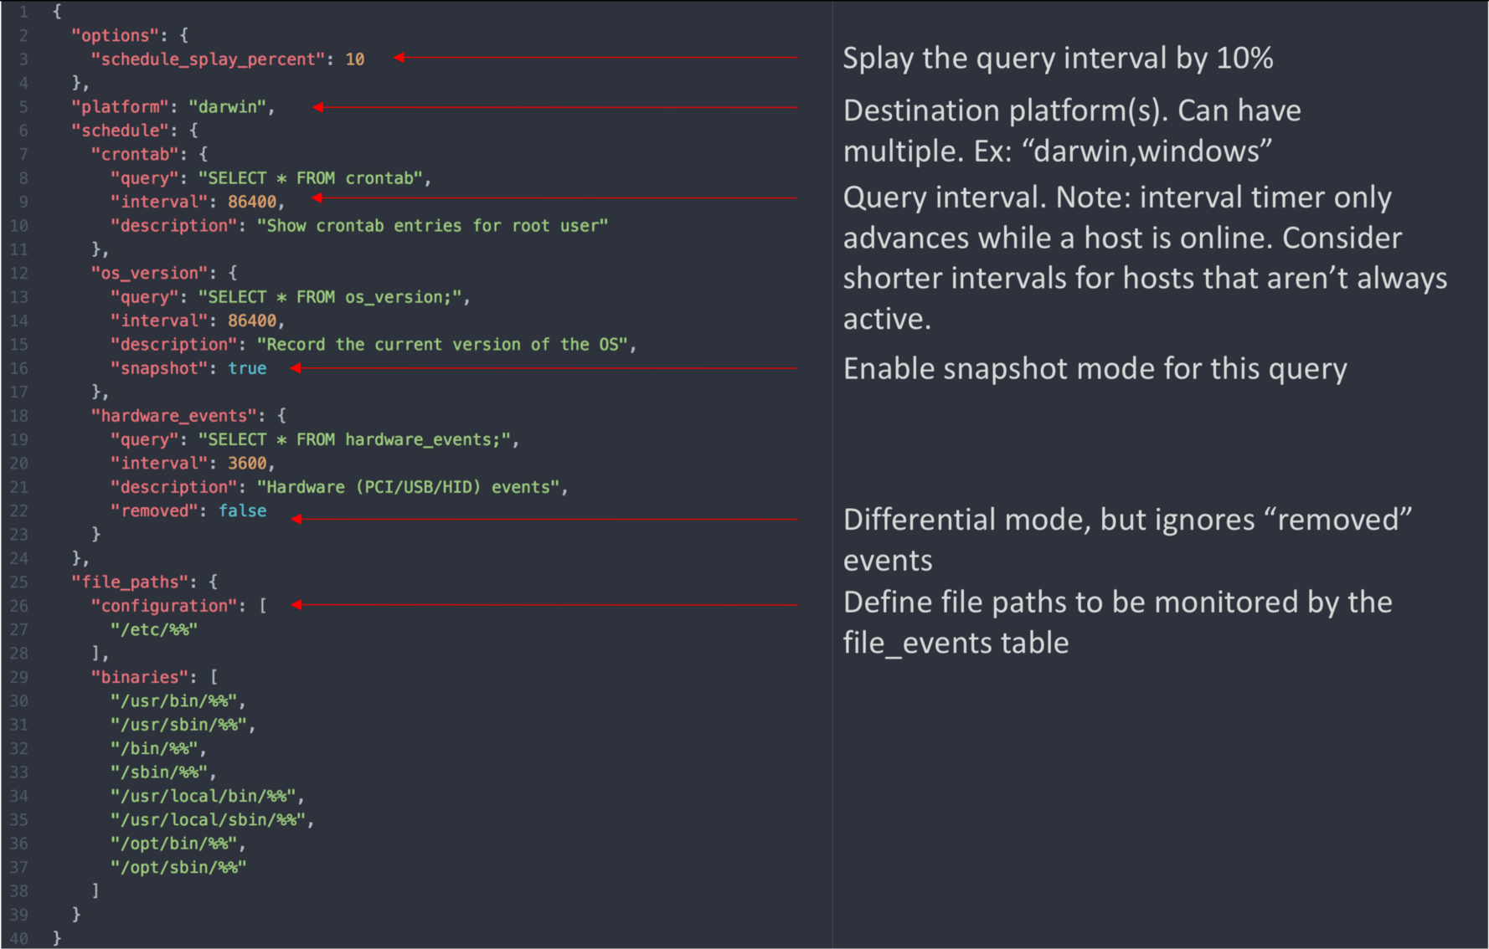
Deploy strategy

Slide 17
Log collection
Tip
https://osquery.readthedocs.io/en/stable/deployment/log-aggregation/
Osquery is designed to work with any environment's existing data infrastructure. Since the problem space of forwarding
logs is so well developed, osquery does not implement log forwarding internally.
Kibana , splunk, Rsyslog, Fluentd, Scribe, etc.

Slide 18
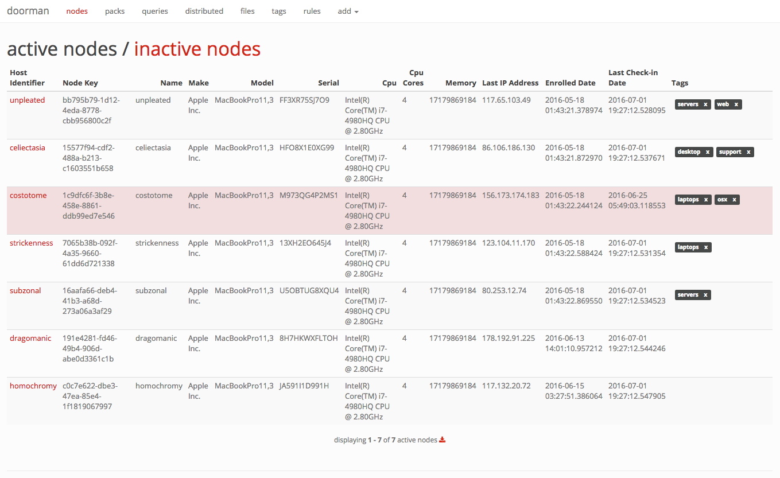
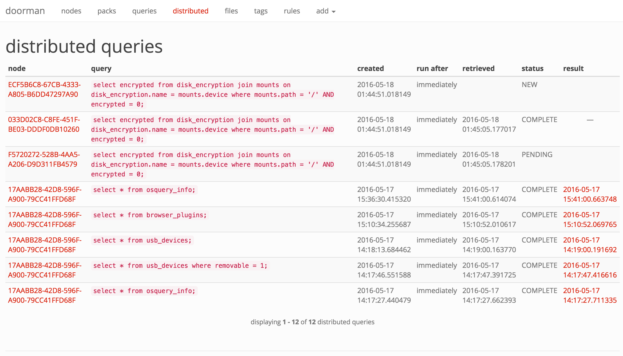
Live queries
https://github.com/mwielgoszewski/doorman

Slide 19
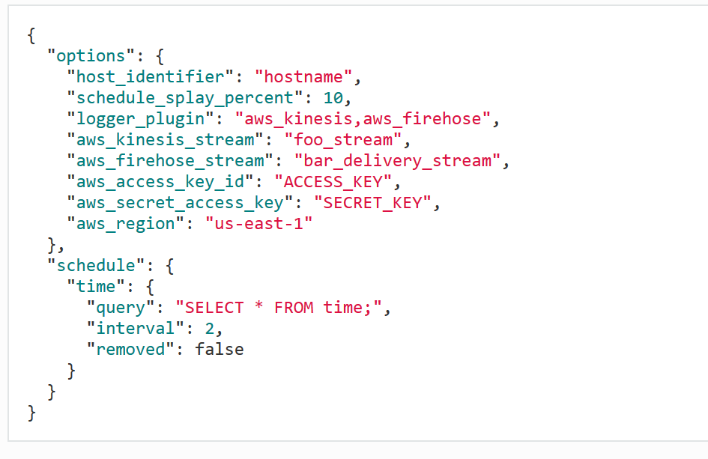
What about global log collection? Firehose on AWS

Slide 20
Tip
http://osquery.io/
https://github.com/facebook/osquery
https://osquery.readthedocs.io/en/stable/
Inference and baseline: what we can realise if you take the conrner cases?

Slide 21
Update and plugin
* How can I update the application?
* What about my unique logs file and event ?

Slide 22
Alternatives?
Facter : Collect and display system facts https://tickets.puppet.com/browse/FACT
Sysdig: Open Source Troubleshooting, Forensics, and Security
https://sysdig.com/opensource/

Slide 23
Questions?
Fabio Nigi - nigifabio@gmail.com
http://osquery.io/
https://github.com/facebook/osquery
https://osquery-slack.herokuapp.com

